Slide 1
First approach : different algorithms for train pictures
BURGERS Gerard
ROGIE Elliot

Slide 2
SIFT : Scale Invariant Feature Transform
4 steps:
Constructing a Scale Space
Keypoint Localisation
Orientation Assignment
Keypoint Descriptor
Notes:
https://www.analyticsvidhya.com/blog/2019/10/detailed-guide-powerful-sift-technique-image-matching-python/

Slide 3
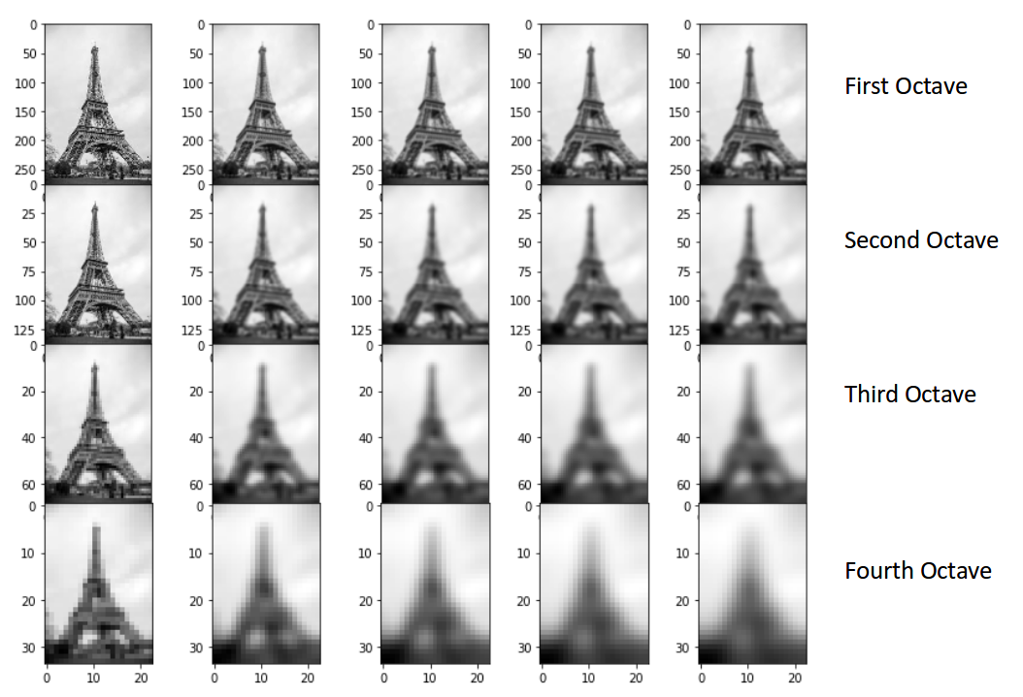
SIFT : Constructing a Scale Space
Divide by 2 the number of pixel (4 time)
Made different level of blur
Use Difference of Gaussian for each octave.
Goal :
Reduce the noise of the picture
Unscale picture

Slide 4
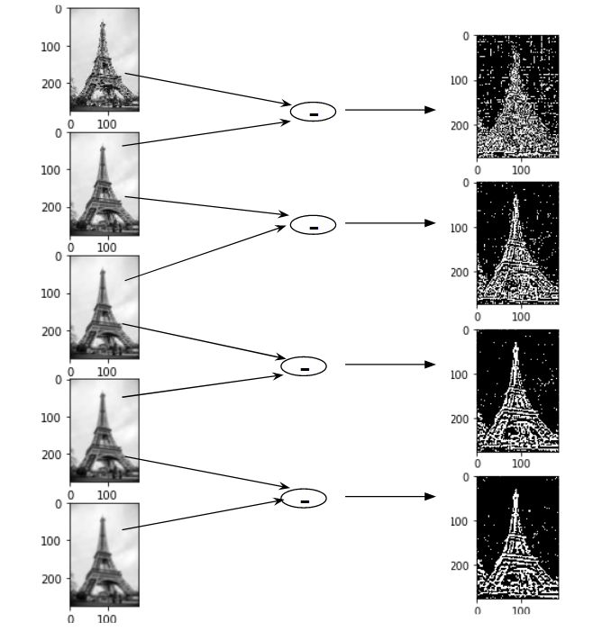
SIFT : Constructing a Scale Space

Slide 5
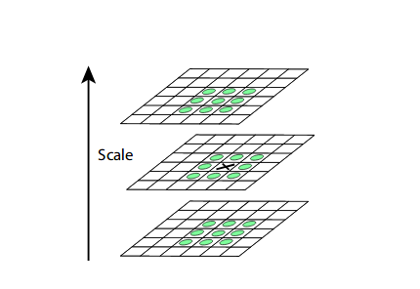
SIFT : Keypoint Localisation
Select extreme contrast point between the 26 pixels around a point (8 point for the picture analysed and 18 for the picture of the octave
Second selection with two tests : low contrast and border
Notes:
a second-order Taylor expansion is computed for each keypoint (test low contrast)
Border : eliminate keypoint if there are to close to the picture border

Slide 6
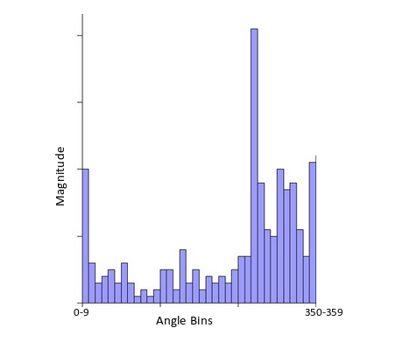
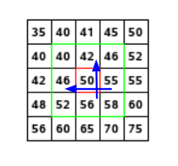
SIFT : Orientation Assignment
For each keypoint, we calculate different the magnitude and the angle.
Made a histogram of all vector of the pixel around the keypoint and the vector of the key point depend of this histogram (show the peak
Notes:
Magnitude = √[(G_{x})²+(G_{y})²]
Φ = atan(Gy / Gx)
I dont understand what is the histogram

Slide 7
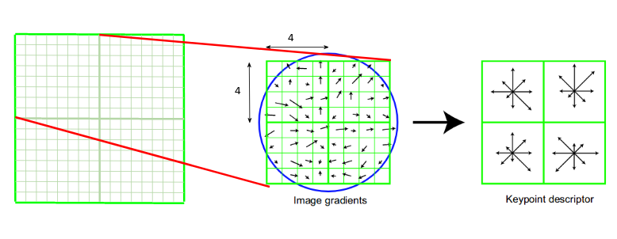
SIFT : Keypoint Descriptor
For each key point make a fingerprint. That mean to have information of the neighbour direction and magnitude

Slide 8
LBPH (Local Binary Patterns Histograms) face recognizer
Condition of working :
Only face pictures (so face detection is already done)
Same size
3 steps:
LBP operations
Extracting histogram
Histogram Compare
Notes:
https://towardsdatascience.com/face-recognition-how-lbph-works-90ec258c3d6b

Slide 9
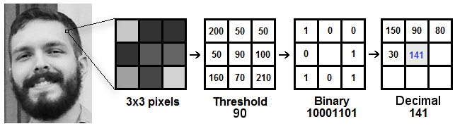
LBPH : LBP operations
Transform the picture to see easily highlighting the facial characteristics .
Choose the radius and the number of neighbour
Transform the neighbour into binary (if the intensity is < of the point put 0 else put 1)

Slide 10
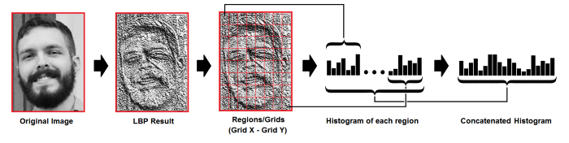
LBPH : Extracting histogram
Divide the picture by grid
For each grid, make an histogram with the occurrence of difference intensity.
Concatenate all histogram

Slide 11
LBPH : Histogram
In this step, you have plenty of histogram (depends of the train data)
With a test picture:
Make the histogram
Find the closest histogram with train data
euclidean distance, chi-square, absolute value methods

Slide 12
Fisher face recognizer
Based on linear discriminant analysis (LDA)
The goal is to maximise the ratio of the between scatter matrix and the whithin scatter matrix

Slide 13
Fisher face recognizer
Transform the picture in vector
Calculate within class scatter and between class scatter
Maximise the ratio
Find the eightvector
Calculate de weight for each face

Slide 14
Thanks you for your intention

